Slide 1
enum in Java

Slide 2
Enum Class
The Enum in Java is a data type which contains a fixed set of constants.
In Java, enumeration is a class type. Although we don’t need to instantiate an enum using new, it has the same capabilities as other classes.
Just like classes, you can give them constructors, add instance variables and methods, and even implement interfaces.
Java enum constants are public, static and final implicitly.
We can define an enum either inside the class or outside the class.
Java Enum internally inherits the Enum class, so it cannot inherit any other class, but it can implement many interfaces.
We can have fields, constructors, methods, and main methods in Java enum.

Slide 3
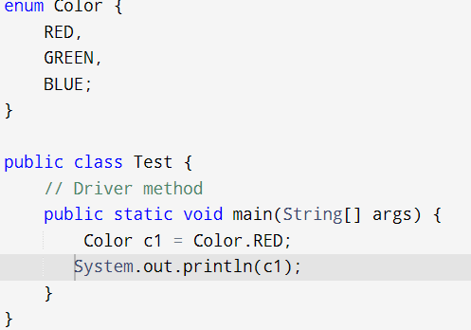
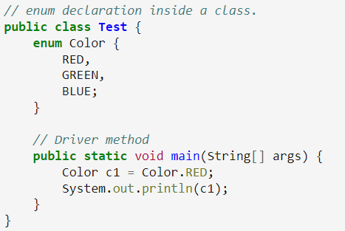
enum
1. Declaration outside the class
2. Declaration in the class
Output:
Red

Slide 4
Properties of enum
Class Type: Every enum is internally implemented using the Class type.
Enum Constants: Each enum constant represents an object of type enum.
Switch Statements: Enum types can be used in switch statements.
Implicit Modifiers: Every enum constant is implicitly public static final. Since it is static, it can be accessed using the enum name. Since it is final, enums cannot be extended.
Main Method: Enums can declare a main() method, allowing direct invocation from the command line.

Slide 5
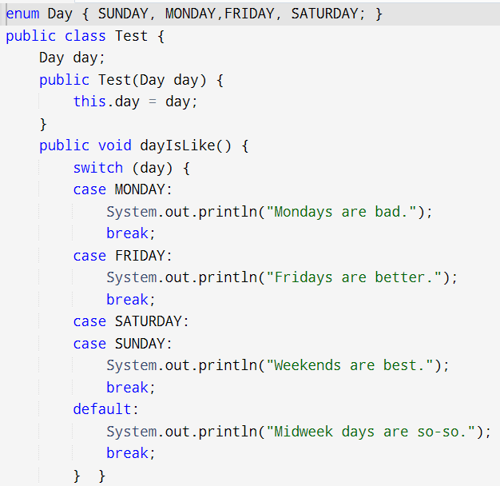
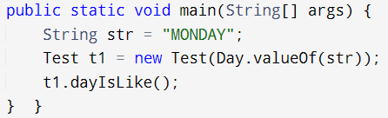
Enum Example
Output:
Mondays are bad.

Slide 6
Values() and valueOf() in Enum
values() method in enum: The values() method returns an array containing all the values of the enum.
valueOf() method in enum: The valueOf() method returns the value of given constant enum.

Slide 7
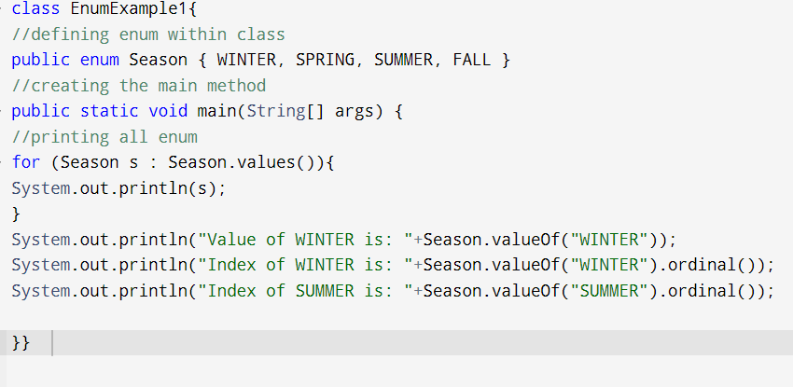
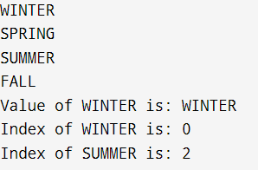
Values() and valueOf() in Enum

